Slide 1
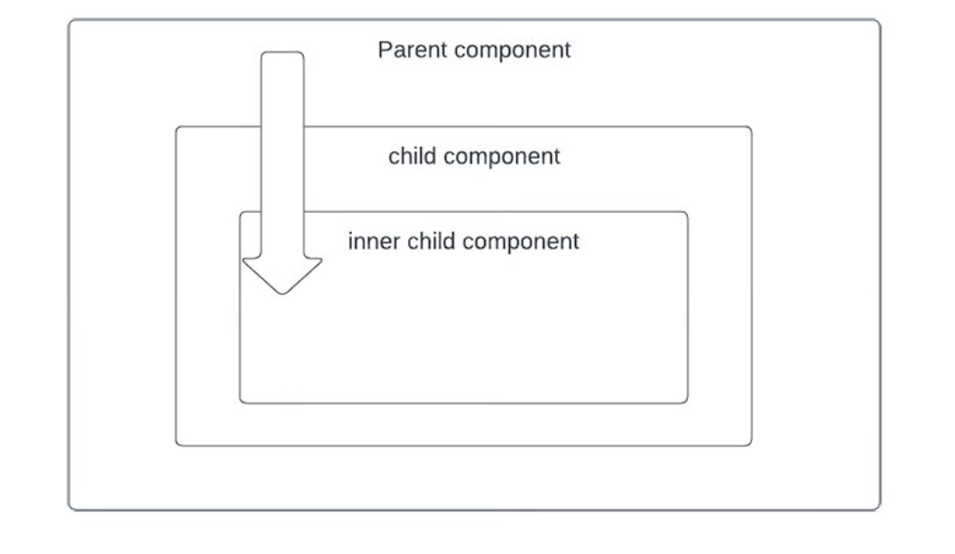
REDUX
1) Redux is a predictable state container designed to help you write JavaScript apps that behave consistently across client, server, and native environments, and are easy to test.

Slide 2
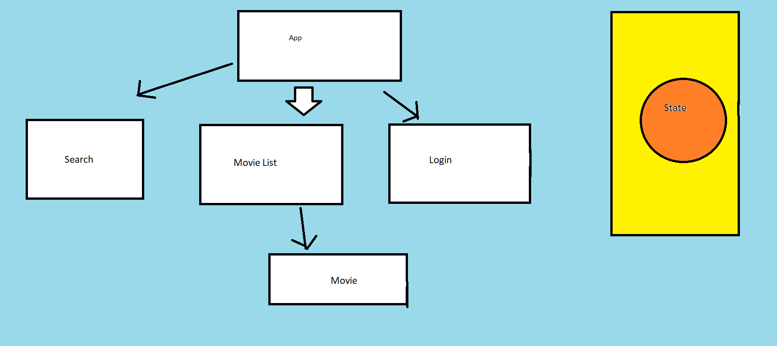
Movie Ticket Booking APP
Store

Slide 3
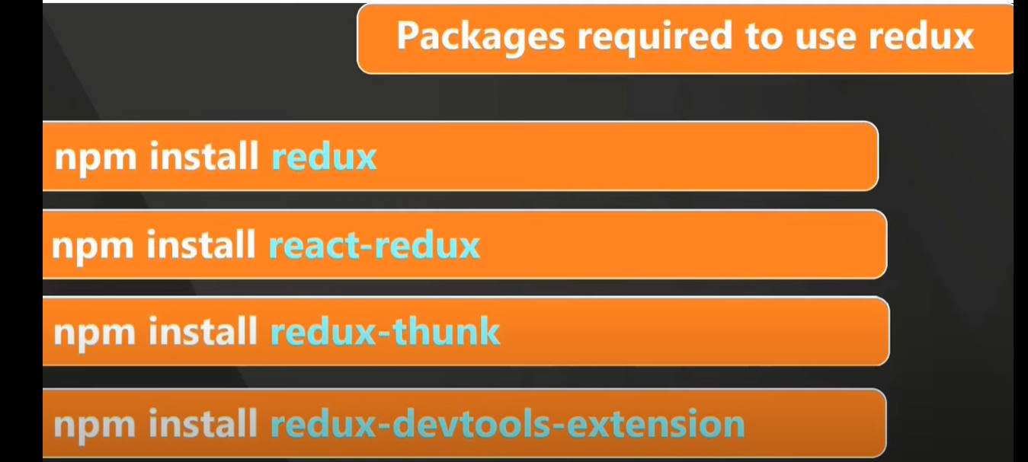
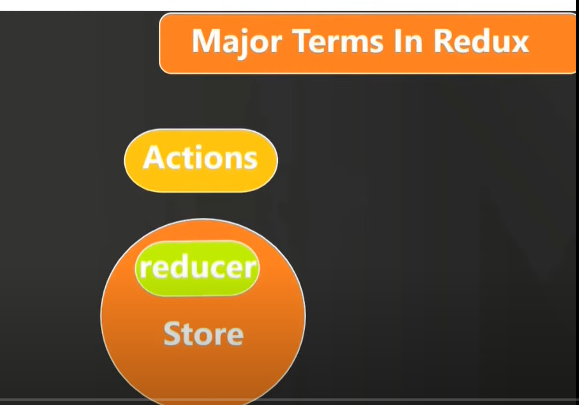

Slide 4
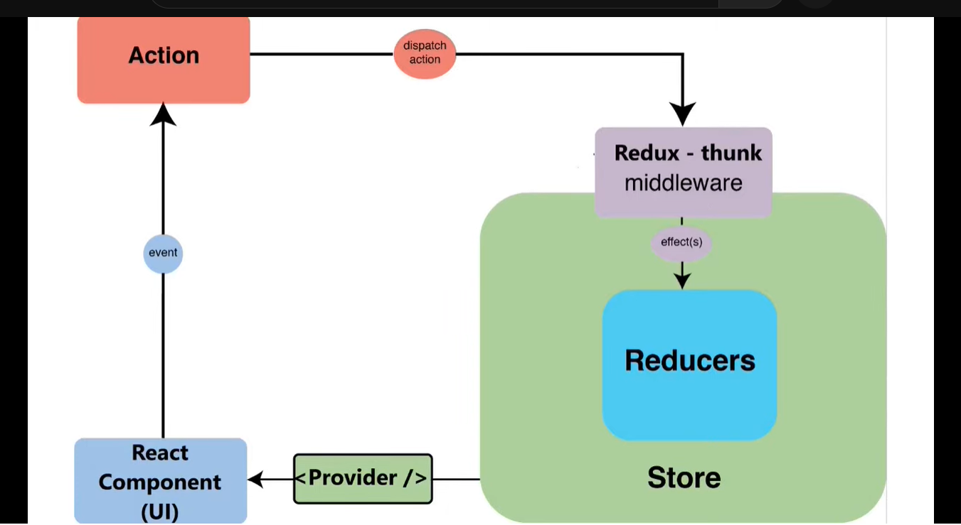

Slide 5
Redux ToolKit
But Recently Redux Team launched Redux Toolkit, an officially recommended and a SOPE library that stands for Simple, Opinionated, Powerful, and Effective state management library.
Disadvantages of a redux:
Configuring a Redux store is too complicated
Have to add a lot of packages to build a large scale application
Redux requires too much boilerplate code which makes it cumbersome to write efficient and clean code.
Dependencies that comes along with Redux Toolkit:
immer
redux
redux-thunk
Reselect
It also provides the automatic support for Redux Dev-tools Extension and for immer.js library which is a great tool to deal with immutable objects.

Slide 6
What Extra Features Are Provided:
configureStore()
createReducer()
createAction()
createSlice()
createAsyncThunk()

Slide 7
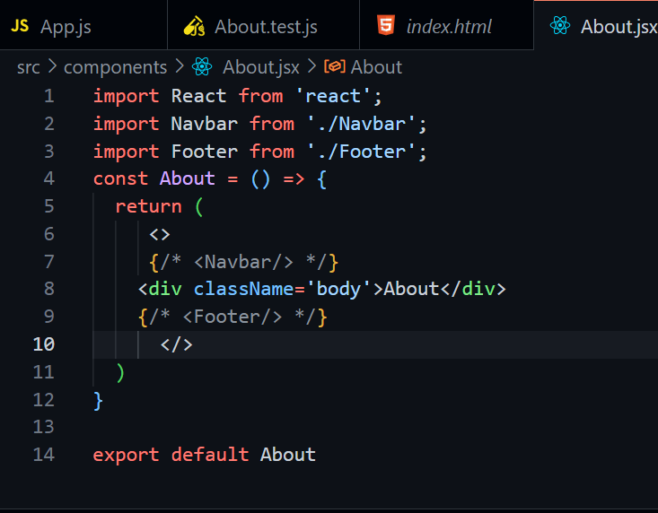

Slide 8
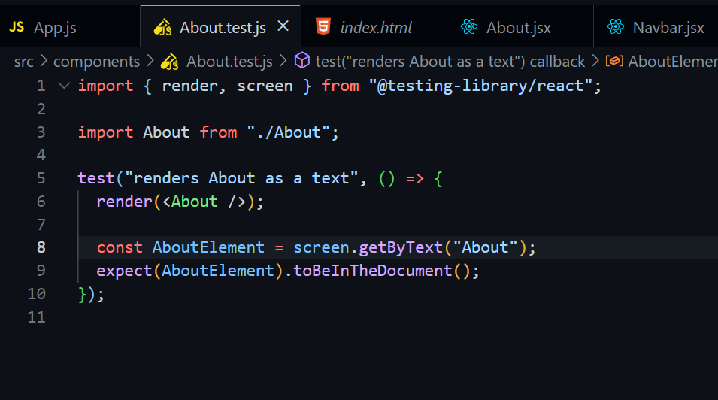

Slide 9
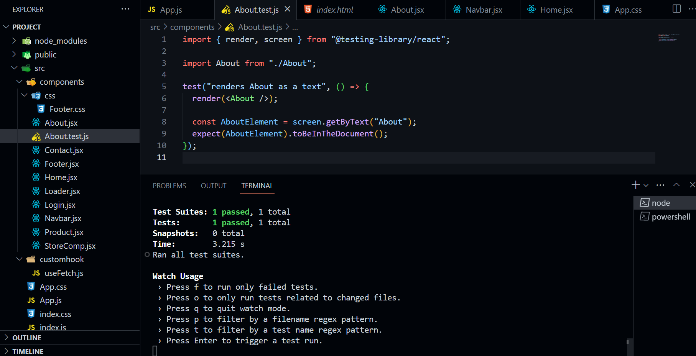

Slide 10
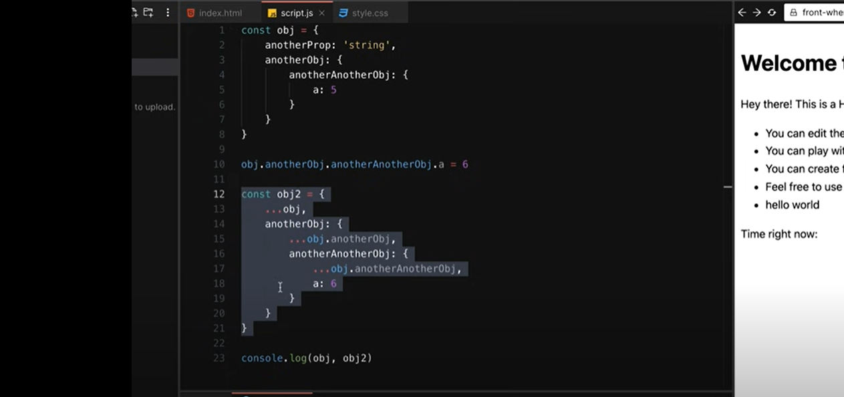
Immer.js(Immutability)

Slide 11
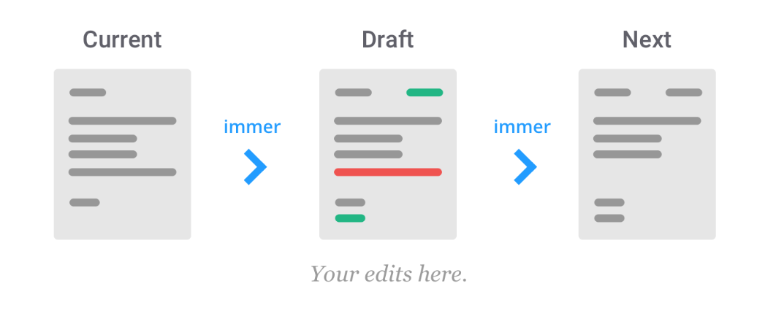
Reference:
https://immerjs.github.io/immer/

Slide 12
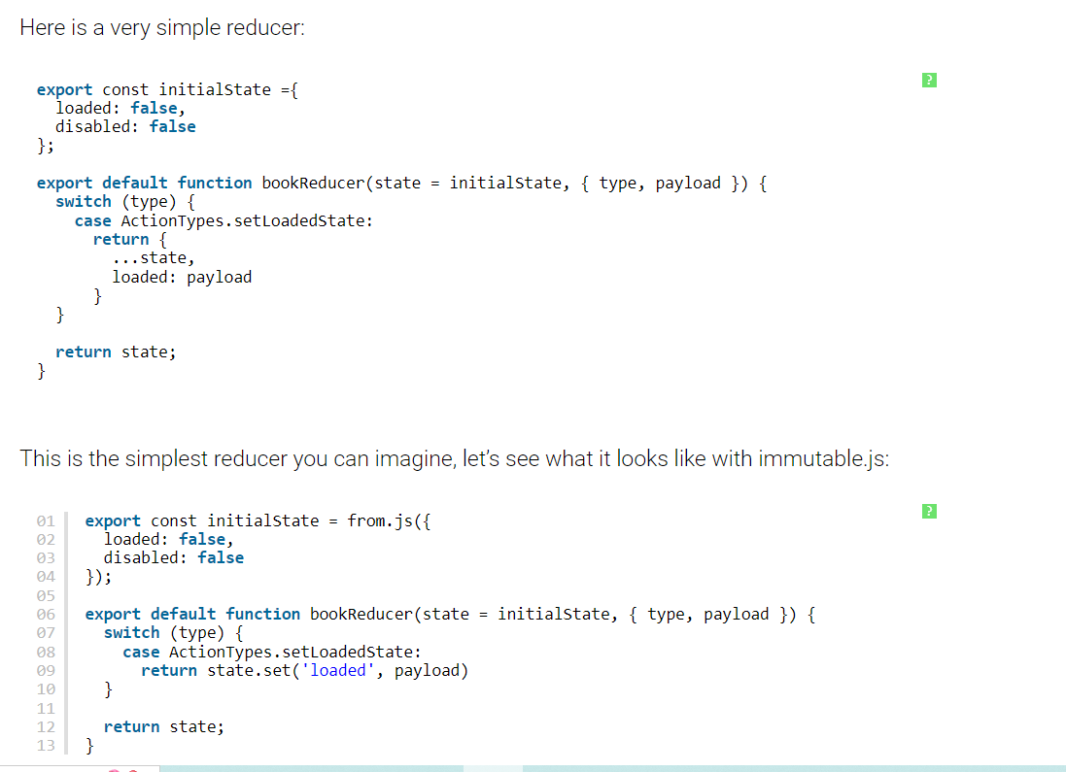

Slide 13
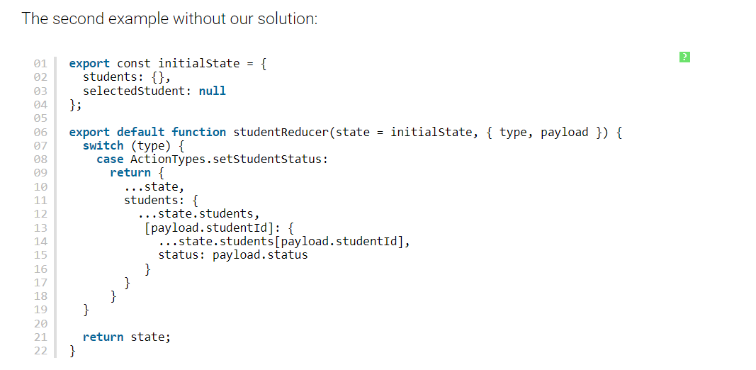

Slide 14
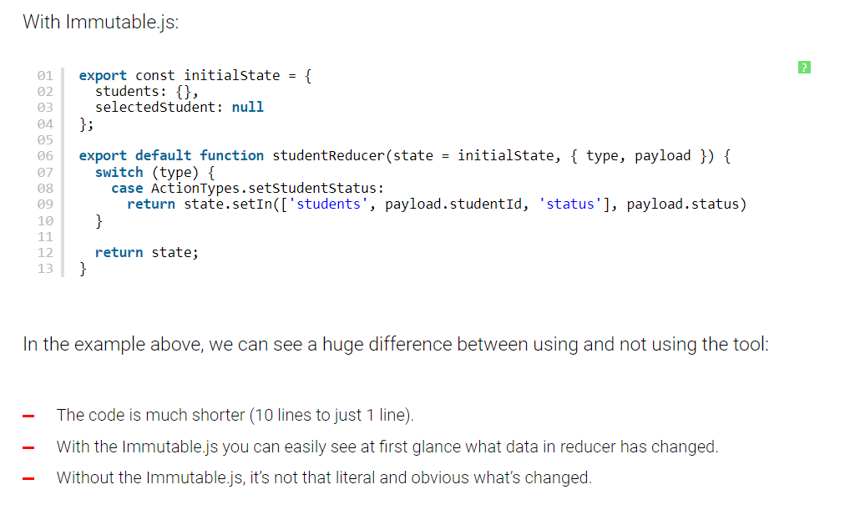

Slide 15


